Slide 1
CYCLISTIC BIKE-SHARE ANALYSIS
A capstone project for Google Data Analytics Professional Certificate
By Godwin France
September 2024

Slide 2




My Bio
BSc. Telecommunication engineering
IT/Telecom, Education, Marketing & Sales
Basketball. Football, Flag football, Running
Digital Assets, machine learning

Slide 3
THE OBJECTIVES
Design marketing strategies aimed at converting casual riders into
annual members.
In order to do that, however, the team needs to better:
1. understand how annual members and casual riders differ,
2. why casual riders would buy a membership, and
3. how digital media could affect their marketing tactics.

Slide 4
THE COMPANY
In 2016, Cyclistic launched a successful bike-share offering. Since then, the program has grown to a fleet of 5,824 bicycles that are geotracked and locked into a network of 692 stations across Chicago. The bikes can be unlocked from one station and returned to any other station in the system anytime.

Slide 5
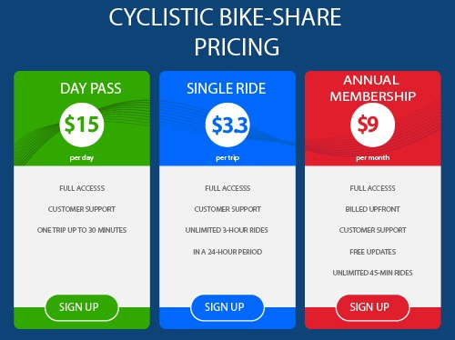
PRICING

Slide 6
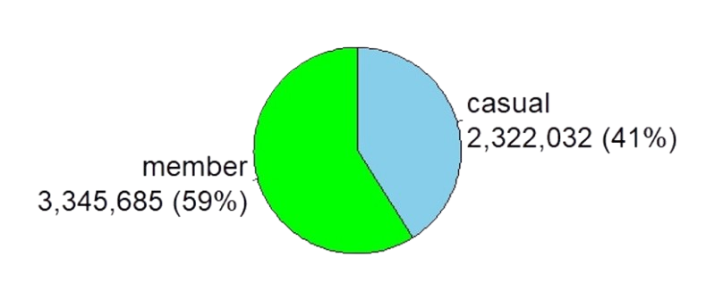
DISTRIBUTION OF 2022 DATA

Slide 7
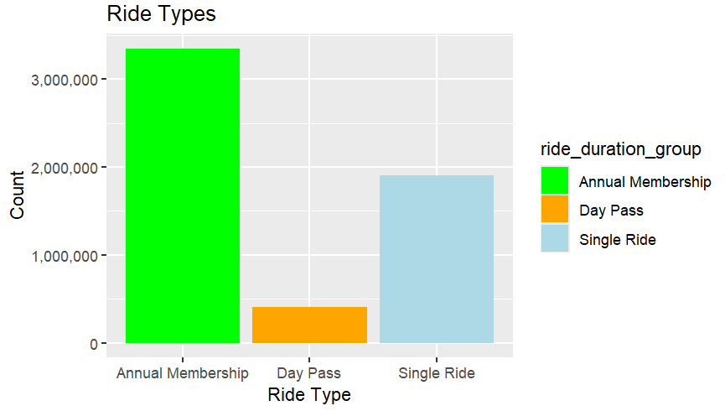
DISTRIBUTION BY RIDE TYPE

Slide 8
—Harvard Business Review
Acquiring a new customer can cost five times more than retaining an existing customer.
Increasing customer retention by 5% can increase profits from 25-95%.
The success rate of selling to a customer you already have is 60-70%, while the success rate of selling to a new customer is 5-20%

Slide 9
Analysis between Day pass vs Single Ride

Slide 10
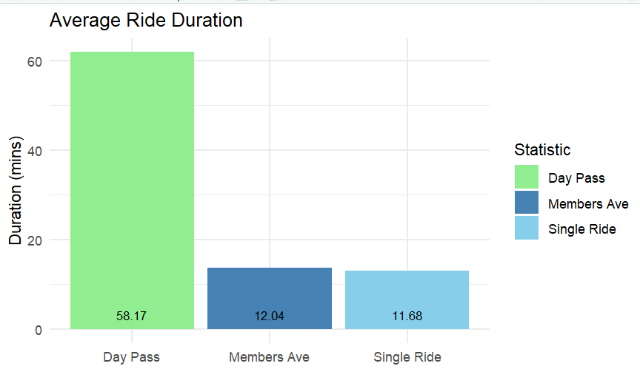
AVERAGE RIDE DURATION
Notes:
This also poses a problem --- is it worth having a membership pass interms of cost whise --- do cost analysis vs minutes?

Slide 11
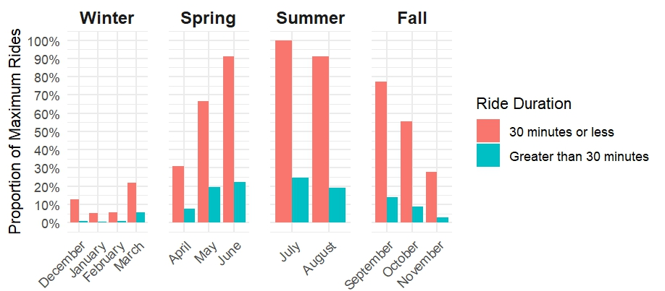
SINGLE RIDE VS DAY PASS - SEASON
Notes:
The single ride users are consist and probably stick to the 30 mins or less, not worth going after as their price point us fair to them. Go after the greater than 30 mins as – removing the average

Slide 12
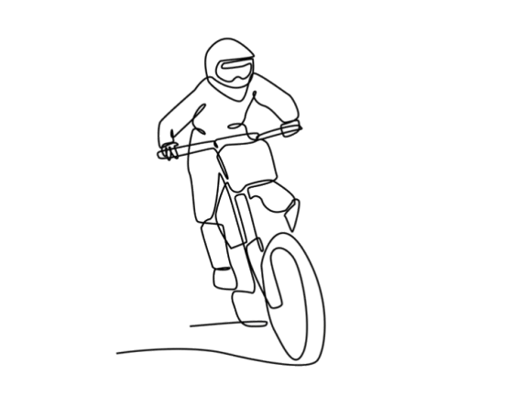
SINGLE RIDE SUMMATION
Average single ride duration is approx. 12 mins same as members pass
there are more users in the casual category that stick to 30 mins or less
apart from the winter season with low patronage, single riders are active most part of the year
recommend annual membership to these users if they do more than two days rides a month
all those averaging 12 minutes should move to membership

Slide 13
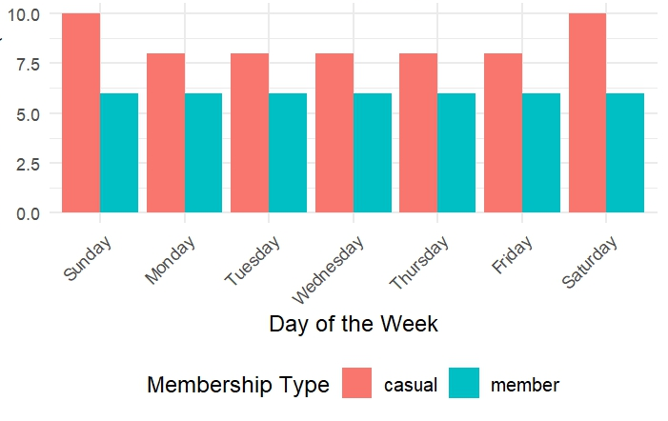
Frequency for days of the week

Slide 14

INSIGHT
Members:
Are consistent with their riding frequency, which is mostly during the week
They do short distance and average 12 minutes
Casuals:
Do more rides over the weekends, likely for leisure
They cover longer distance – probably due to the Day Pass users

Slide 15
RECOMMENDATION
Rec 1: Create promotional campaigns that focus on the advantages of an annual membership for leisure use, such as easy access to bikes during busy weekends and events.
Rec 2: Create a membership tier for longer ride
Rec 3: Introduce monthly or seasonal membership options for casual riders who may not want to commit to a full year, allowing them to try out membership before making a longer-term commitment.
Rec 4: Allow members to reserve bikes in advance at key stations, especially during peak hours or events, ensuring they always have access when they need it.
Rec 5: Geotargeting and time-based ads (e.g., weekends, evenings) to reach casual riders and show the benefits of becoming members, such as unlimited rides and cost savings.

Slide 16
DATA SOURCE
Integrity: very high, first party source
License: via Data License Agreement
CHALLENGES
Not able to identify duplicate entries or unique rider
No tag for Single Ride and Day Pass riders. Casual riders were identified by averaging ride duration and estimations
No means to fill in or correct data with errors – deleted rows with such occurrences

Slide 17
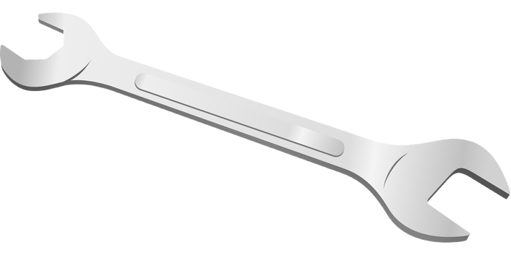
TOOLS
MS Excel
Python
R Programming language

Slide 18
THANKS!
Do you have any questions?
youremail@freepik.com
+34 654 321 432
yourwebsite.com
Please keep this slide for attribution

